Slide 1
FOR PASTORS & MINISTRY LEADERS
The Financial
Wisdom Ministry
Integrating financial wisdom into the DNA of your church.

Slide 2
“
God’s Word speaks authoritatively and timelessly to all financial planning and decision making — providing us with wisdom for the process and principles for the decision.
— RON BLUE
The Church is God’s chosen organization for making disciples. We are not proposing one more program — we want to come alongside you and help your church become a center of biblical financial wisdom and discipleship.

Slide 3
ELEVATING THE VISION
From a Program to a Culture
PROGRAMMATIC STEWARDSHIP
FINANCIAL WISDOM DNA
Occasional sermon series
Integrated into the church’s DNA
Giving campaigns
A holistic approach for all financial stages
One-off small-group studies
Continuous, intentional practice
Focused on a single, transactional goal
Focused on lifelong heart transformation

Slide 4
COMING ALONGSIDE YOUR WORK
Honoring the Foundation You’ve Already Built
1
2
3
Annual Sermon Series
Successful Capital Campaigns
Foundational Classes
Faithful, recurring teaching on stewardship and generosity.
Vision-casting that mobilizes the congregation to give.
Small groups and studies that ground people in the Word.

Slide 5
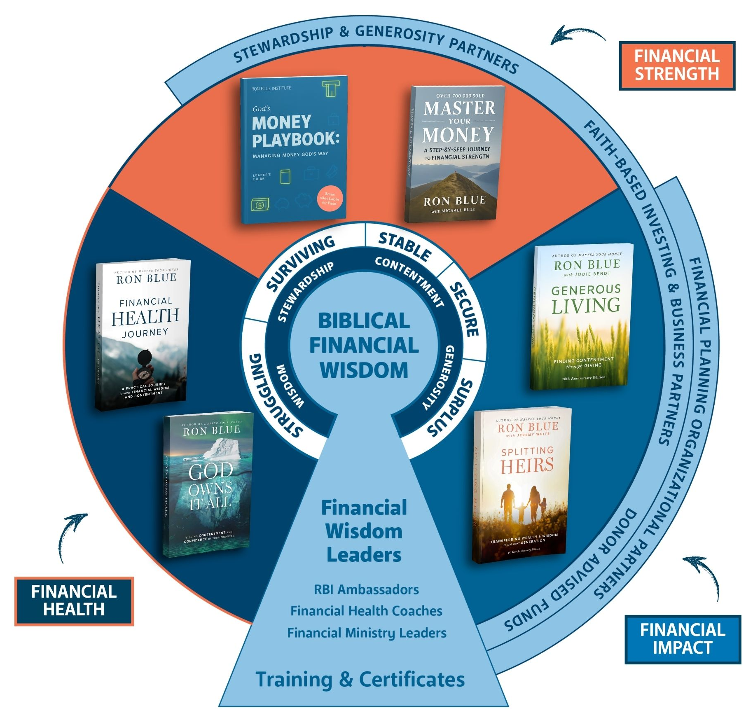
THE BIG PICTURE
The Biblical Financial Wisdom Framework
Every resource, role, and partner in the Financial Wisdom Ministry orbits one center: biblical financial wisdom.
The journey carries a congregation from struggling toward surplus — and from financial health, to strength, to Kingdom impact.
“Transforming the way Christians think, act, and communicate about money and possessions.”

Slide 6
HOW WE HELP
One Ministry, Built on Three Pillars
One ministry, supported on three pillars — and we build it alongside you.
1
2
3
Support Your Pastoral Staff
Integrate Into Existing Ministries
Disciple Your Congregation
Coaching, partners, peer churches, and a clear path with tools for the journey.
Financial wisdom across every age, stage, and ministry you already lead.
Ready-to-use content and steady rhythms that form the whole church over time.

Slide 7
PILLAR ONE
Dedicated Support for Your Leaders
Coaching, partners, peers, and a clear path — you are not building this alone.
1
Coaching & Ambassador Support
2
Connection to Implementing Churches
A trained RBI Ambassador and team walk the journey alongside you.
Learn with churches already building a financial wisdom ministry.
3
Connection to Premier Players
4
A Path & Tools for the Journey
Introductions across the biblical financial-wisdom ecosystem.
A clear Roadmap, plus the Guide, Source Book, and Field Guide.

Slide 8
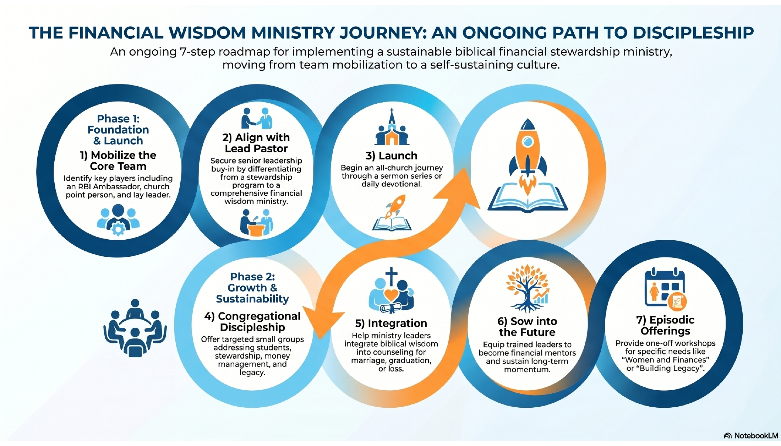
PILLAR ONE · A PATH & TOOLS
Your Roadmap for the Journey
A flexible, non-linear path — begin where your church is ready and adapt to your context.

Slide 9
PILLAR ONE · A PATH & TOOLS
Tools to Equip the Pastor
Trusted resources that put the path within reach — built on the work of a dozen pilot churches.
G
S
F
The Guide
The Source Book
The Field Guide
Professional expertise and support from an RBI Ambassador and team member.
Curated access to all Ron Blue content and premier partner organizations.
Nuts-and-bolts execution — how to host a Lunch & Learn or start a small group.

Slide 10
PILLAR TWO
Integrate Into Existing Ministries
How does biblical financial wisdom intersect with the ministry you are already doing?
Marriage Mentoring
+ FW
helps couples align their values and decisions around money.
Career Counseling
+ FW
brings a biblical perspective into vocational decision-making.
Care Ministry
+ FW
equips a care minister to help a grieving spouse navigate sudden decisions.

Slide 11
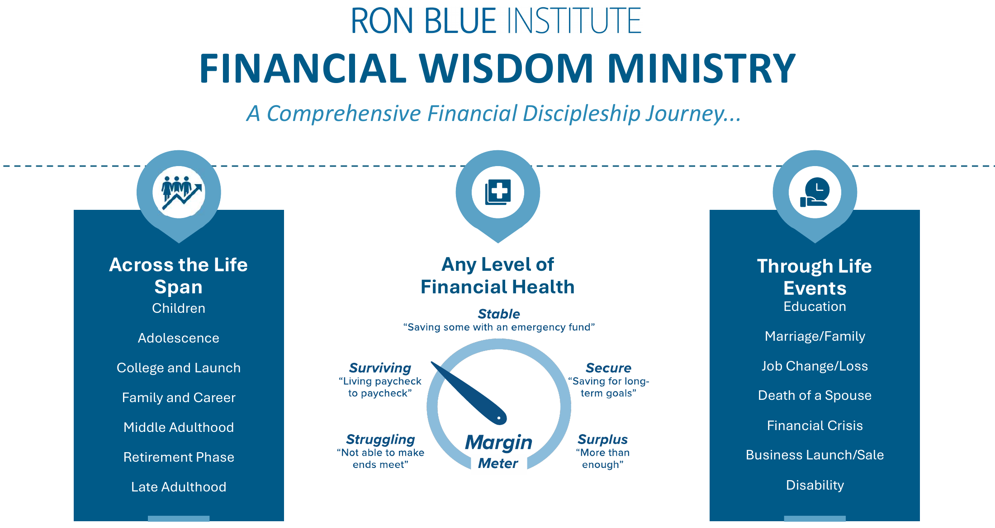
PILLAR TWO · EVERY AGE & STAGE
Financial Discipleship for the Whole Church
The same wisdom meets every member — across the life span, at any level of financial health, through every life event.

Slide 12
PILLAR THREE
Discipleship of the Congregation
A continuous rhythm of teaching, formation, and practice — not a single event.
Devotional Campaigns
Small-Group Curriculums
Sermon Series
One-off Workshops
Mentor Training
Lunch & Learns

Slide 13
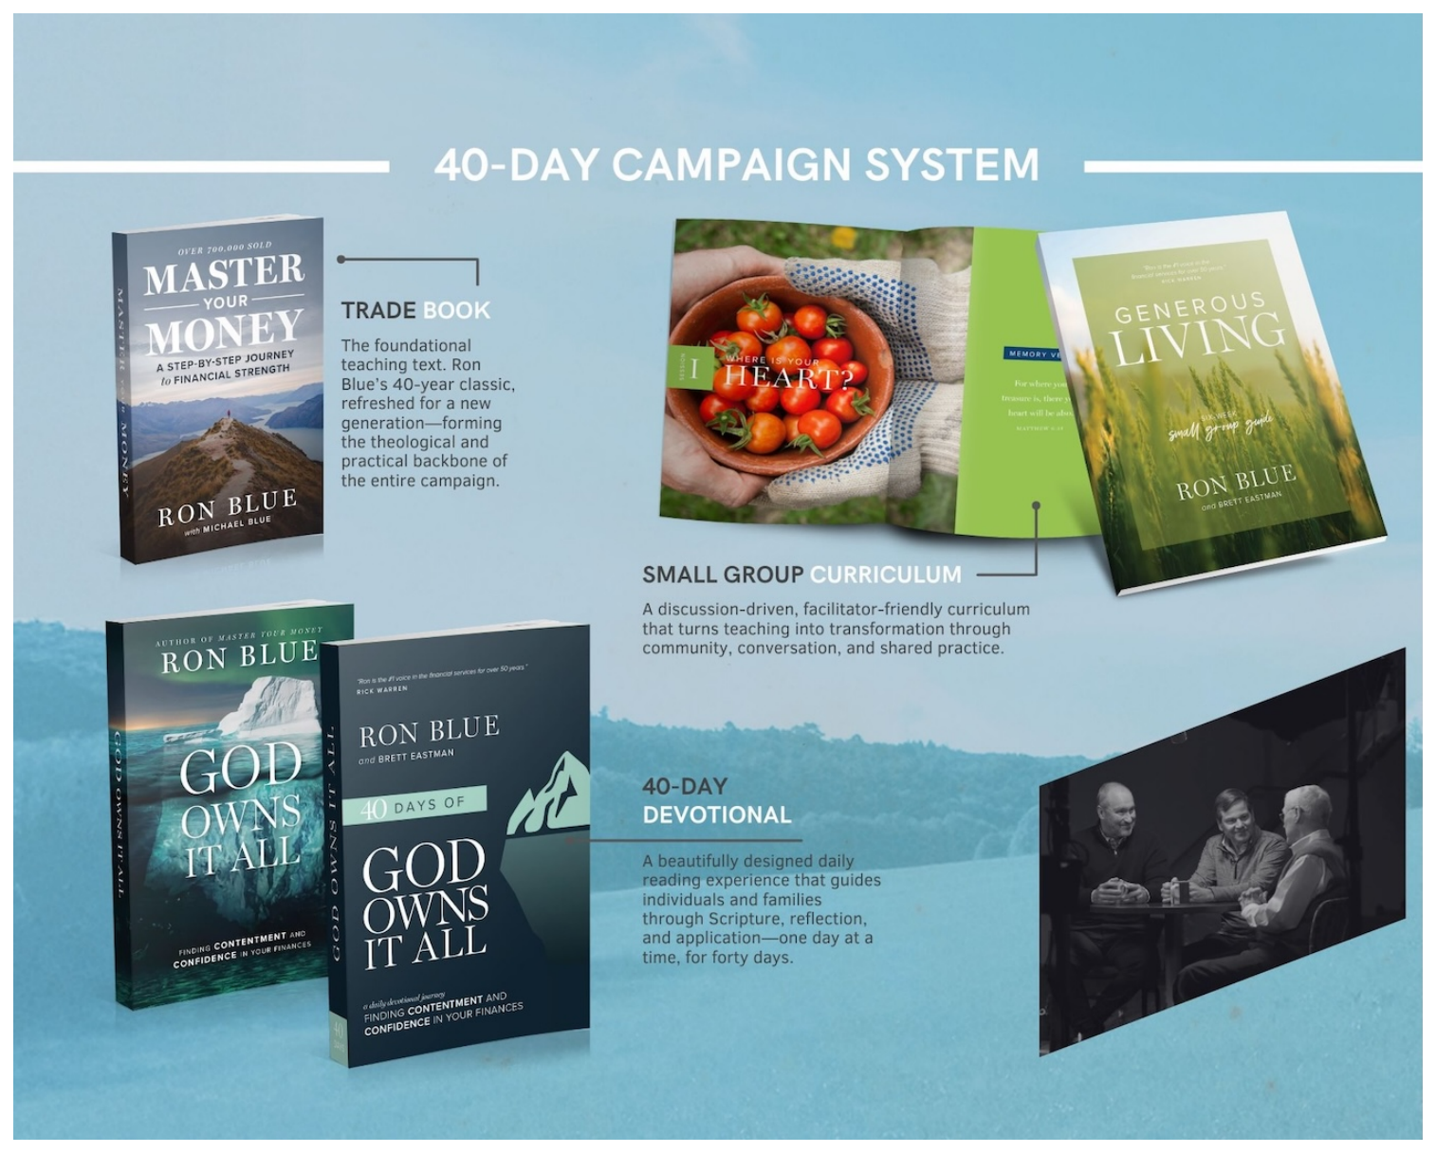
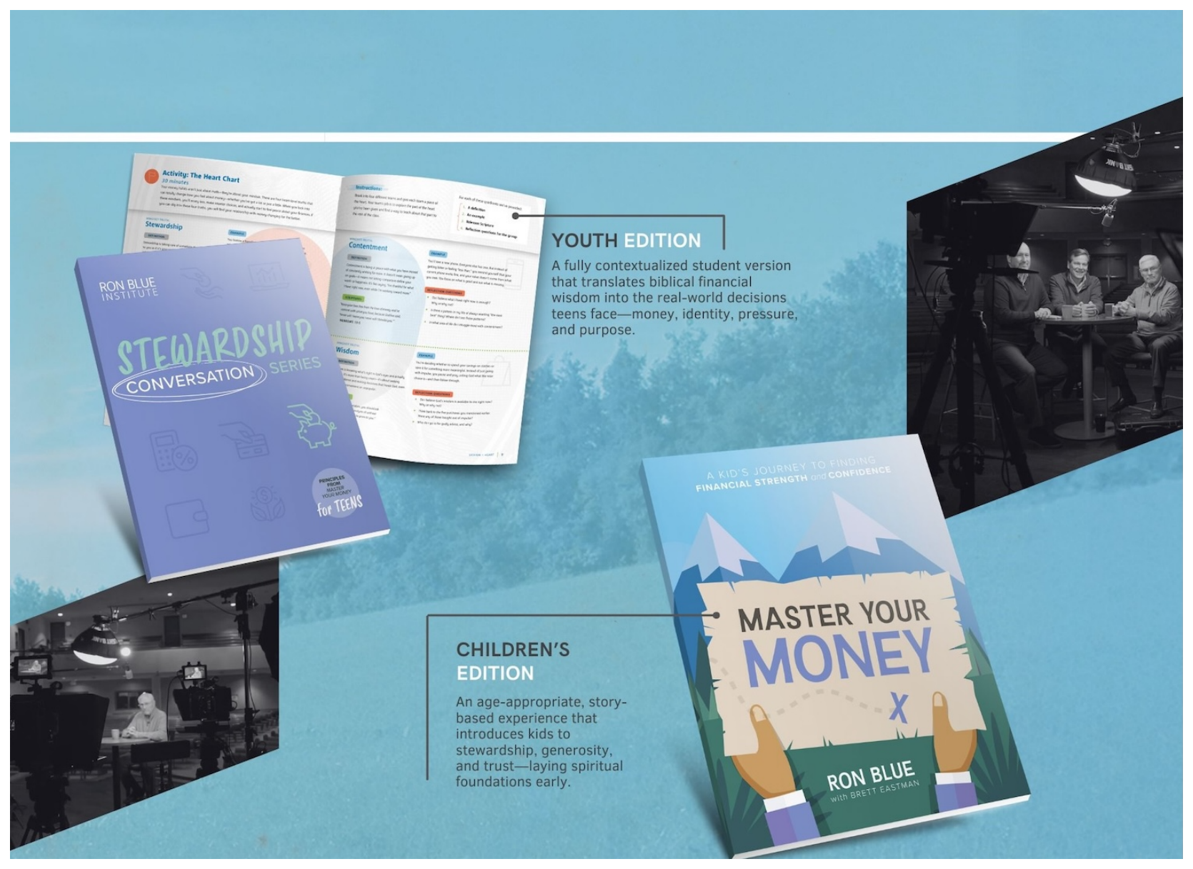
PILLAR THREE · READY-TO-USE CONTENT
Content & Curriculum for Every Age & Stage
White-labeled resources — from a full church campaign to youth and children’s ministry.
The 40-Day Campaign System
Youth & Children’s Curriculum

Slide 14
THE FRUIT OF THE JOURNEY
Real Change — in the Books and in the Heart
Financial breakthrough is the gateway — but the deeper fruit is a transformed heart and home.
FINANCIAL BREAKTHROUGH
HEART & HOME
Reduced Debt
Decreased Anxiety
Decreased Conflict
Increased Giving
Increased Peace
Increased Contentment
The visible first fruits — margin that frees a family to give and serve.
As the heart changes, anxiety and conflict give way to peace and contentment.

Slide 15
THE HEART OF THE JOURNEY
God Owns It All — We Are Stewards
Beneath every metric is a deeper transformation — one that reshapes a life, a home, and a church.
1
2
3
A Steward’s Heart
An Aligned Life
Ushering In His Kingdom
We realize God owns it all and our role is simply that of a steward — and a deep transformation begins.
Our lives begin to align with that truth, and our spending aligns with what we believe.
When a whole church lives this way, funding for Kingdom causes grows — and together we help usher in His Kingdom.

Slide 16
BEGIN THE JOURNEY
Let’s cast the vision for your team
and customize your Roadmap.
Tricia Gleghorn
TGleghorn@RonBlueInstitute.com

